Slide 1
DSA LAB

Slide 2
Experiment List
Implementation of Infix to Postfix expression-Transformation and its evaluation program
Write a program that uses functions to perform the following operations on singly linked list i) Creation ii) Insertion iii) Deletion iv) Traversal.
Implementation of Stack and queue using doubly linked List
Implementation of Polynomial addition using linked list
Implementation of double ended queue
Implementation of Fibonacci search and Binary search
Implementation of Insertion and selection sort
Implementation of BST
Implementation of BFS and DFS traversal
Implementation of hashing functions with different collision resolution techniques

Slide 3
Online compilers for C
Online C compiler-online editor
Online C compiler IDE-Jdoodle
Online C compiler –my Compiler

Slide 4
Implementation of Infix to Postfix expression-Transformation and its evaluation program
Algorithm
Let, X is an arithmetic expression written in infix notation. This algorithm finds the equivalent postfix expression Y.
Push “(“onto Stack, and add “)” to the end of X.
Scan X from left to right and repeat Step 3 to 6 for each element of X until the Stack is empty.
If an operand is encountered, add it to Y.
If a left parenthesis is encountered, push it onto Stack.
If an operator is encountered ,then:
Repeatedly pop from Stack and add to Y each operator (on the top of Stack) which has the same precedence as or higher precedence than operator.
Add operator to Stack. [End of If]
7. If a right parenthesis is encountered ,then:
Repeatedly pop from Stack and add to Y each operator (on the top of Stack) until a left parenthesis is encountered.
Remove the left Parenthesis. [End of If] [End of If]
8. END.

Slide 5
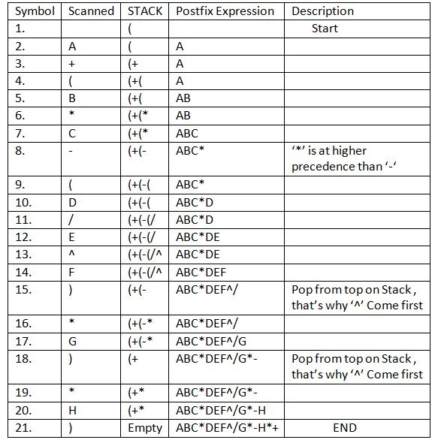
Example

Slide 6
Evaluation of Postfix expression
The algorithm for evaluation of postfix expression is as follows -
Create a stack that holds integer type data to store the operands of the given postfix expression. Let it be st.
Iterate over the string from left to right and do the following -
If the current element is an operand, push it into the stack.
Otherwise, if the current element is an operator (say /)do the following -
Pop an element from st, let it be op2.
Pop another element from st, let it be op1.
Computer the result of op1 / op2, and push it into the stack. Note the order i.e.i.e. op1 / op2 should not be changed otherwise it will affect the final result in some cases.
At last, st will consist of a single element i.e. the result after evaluating the postfix expression.

Slide 7
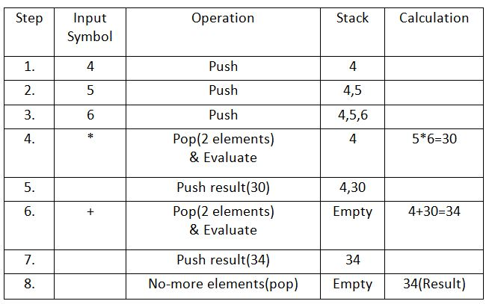
Example

Slide 8
Singly Linked List
There are various linked list operations that allow us to perform different actions on linked lists. For example, the insertion operation adds a new element to the linked list.
Here's a list of basic linked list operations that we will cover in this article.
Traversal - access each element of the linked list
Insertion - adds a new element to the linked list
Deletion - removes the existing elements
Search - find a node in the linked list
Sort - sort the nodes of the linked list

Slide 9
Things to Remember about Linked List
head points to the first node of the linked list
next pointer of the last node is NULL, so if the next current node is NULL, we have reached the end of the linked list.
In all of the examples, we will assume that the linked list has three nodes 1 --->2 --->3 with node structure as below:
struct node
{
int data;
struct node *next;
};

Slide 10
Traverse a Linked List
Displaying the contents of a linked list is very simple. We keep moving the temp node to the next one and display its contents.
When temp is NULL, we know that we have reached the end of the linked list so we get out of the while loop.
struct node *temp = head;
printf("\n\nList elements are - \n");
while(temp != NULL) {
printf("%d --->",temp->data);
temp = temp->next;
}
The output of this program will be:
List elements are -
1 --->2 --->3 --->

Slide 11
Insert Elements to a Linked List
You can add elements to either the beginning, middle or end of the linked list.
1. Insert at the beginning
Allocate memory for new node
Store data
Change next of new node to point to head
Change head to point to recently created node
struct node *newNode;
newNode = malloc(sizeof(struct node));
newNode->data = 4;
newNode->next = head;
head = newNode;

Slide 12
Insert Elements to a Linked List
2. Insert at the End
Allocate memory for new node
Store data
Traverse to last node
Change next of last node to recently created node
struct node *newNode;
newNode = malloc(sizeof(struct node));
newNode->data = 4;
newNode->next = NULL;
struct node *temp = head;
while(temp->next != NULL){
temp = temp->next;
}
temp->next = newNode;

Slide 13
Insert Elements to a Linked List
3. Insert at the Middle
Allocate memory and store data for new node
Traverse to node just before the required position of new node
Change next pointers to include new node in between
struct node *newNode;
newNode = malloc(sizeof(struct node));
newNode->data = 4;
struct node *temp = head;
for(int i=2; i < position; i++) {
if(temp->next != NULL) {
temp = temp->next;
}
}
newNode->next = temp->next;
temp->next = newNode;

Slide 14
Delete elements from linked list
You can delete either from the beginning, end or from a particular position.
1. Delete from beginning
Point head to the second node
head = head->next;
2. Delete from end
Traverse to second last element
Change its next pointer to null
struct node* temp = head;
while(temp->next->next!=NULL){
temp = temp->next;
}
temp->next = NULL;

Slide 15
Delete elements from linked list
3. Delete from middle
Traverse to element before the element to be deleted
Change next pointers to exclude the node from the chain
for(int i=2; i< position; i++) {
if(temp->next!=NULL) {
temp = temp->next;
}
}
temp->next = temp->next->next;

Slide 16
Search elements on linked list
You can search an element on a linked list using a loop using the following steps. We are finding item on a linked list.
Make head as the current node.
Run a loop until the current node is NULL because the last element points to NULL.
In each iteration, check if the key of the node is equal to item. If it the key matches the item, return true otherwise return false.
// Search a node
bool searchNode(struct Node** head_ref, int key) {
struct Node* current = *head_ref;
while (current != NULL) {
if (current->data == key) return true;
current = current->next;
}
return false;
}

Slide 17
Sort elements of a Linked List
We will use a simple sorting algorithm, Bubble Sort, to sort the elements of a linked list in ascending order below.
Make the head as the current node and create another node index for later use.
If head is null, return.
Else, run a loop till the last node (i.e. NULL).
In each iteration, follow the following step 5-6.
Store the next node of current in index.
Check if the data of the current node is greater than the next node. If it is greater, swap current and index.

Slide 18
Sort elements of a Linked List
void sortLinkedList(struct Node** head_ref)
{
struct Node *current = *head_ref, *index = NULL;
int temp;
if (head_ref == NULL) {
return;
} else {
while (current != NULL) {
// index points to the node next to current
index = current->next;
while (index != NULL) {
if (current->data > index->data) {
temp = current->data;
current->data = index->data;
index->data = temp;
}
index = index->next;
}
current = current->next;
}
}
}

Slide 19
Stack using doubly linked list
Functions to be Implemented:
Some of the basic functionalities on a stack covered here are:
push()
pop()
isEmpty()
printstack()
stacksize()
topelement()

Slide 20
Stack using doubly linked list
Push()
If the stack is empty then take a new node, add data to it and assign “null” to its previous and next pointer as it is the first node of the DLL. Assign top and start as the new node. Otherwise, take a new node, add data to it and assign the “previous” pointer of the new node to the “top” node earlier and next as “null”. Further, update the “top” pointer to hold the value of the new node as that will be the top element of the stack now.
void push(int d)
{
struct Node* n;
n = new Node();
n->data = d;
if (isEmpty()) {
n->prev = NULL;
n->next = NULL;
As it is first node
// if stack is empty
start = n;
top = n;
}
else {
top->next = n;
n->next = NULL;
n->prev = top;
top = n;
}
}

Slide 21
Stack using doubly linked list
Pop()
If the stack is empty, then print that stack is empty, Otherwise, assign top ->prev -> next as “null” and assign top as top->prev.
void pop()
{
struct Node* n;
n = top;
if (isEmpty())
printf("Stack is empty");
else if (top == start) {
top = NULL;
start = NULL;
free(n);
}
else {
top->prev->next = NULL;
top = n->prev;
free(n);
}
}

Slide 22
Stack using doubly linked list
PritnStack()
If the stack is empty, then print that stack is empty. Otherwise, traverse the doubly linked list from start to end and print the data of each node.
oid printstack()
{
if (isEmpty())
printf("Stack is empty");
else {
struct Node* ptr = start;
printf("Stack is : ");
while (ptr != NULL) {
printf("%d ", ptr->data);
ptr = ptr->next;
}
printf("\n");
}

Slide 23
Stack using doubly linked list
StackSize ()
If the stack is empty, then return zero else iterate from the start to end and count the number of nodes of the doubly linked list.
void stacksize()
{
int c = 0;
if (isEmpty())
printf("Stack is empty");
else {
struct Node* ptr = start;
while (ptr != NULL) {
c++;
ptr = ptr->next;
}
}
printf(" Size of the stack is : %d \n ", c);
}

Slide 24
Stack using doubly linked list
topElement
If the stack is empty, then there is no top element. Otherwise, print the element at the top node of the stack.
void topelement()
{
if (isEmpty())
printf("Stack is empty");
else
printf(
"The element at top of the stack is : %d \n",
top->data);
}

Slide 25
Stack using doubly linked list
topElement
If the stack is empty, then there is no top element. Otherwise, print the element at the top node of the stack.
void topelement()
{
if (isEmpty())
printf("Stack is empty");
else
printf(
"The element at top of the stack is : %d \n",
top->data);
}

Slide 26
Queue using doubly linked list
Functions to be Implemented:
Some of the basic functionalities on a stack covered here are:
enqueue()
dequeue()
isSize()
peek()
isEmpty()
printQdata()

Slide 27
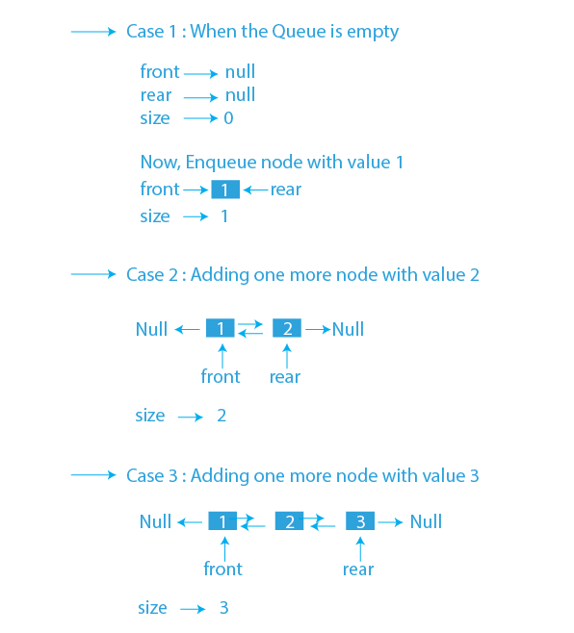
Queue using doubly linked list
Enqueue: This function is used to add an element in the queue in the rear end. There is a ref pointer of the doubly linked list which has a rear, front, and size pointer. In the case of enqueueing, we will add data in the new node and will pass it to the next pointer of the rear node. Also, we will increment the size pointer by 1 in case of insertion.

Slide 28
Queue using doubly linked list
Insertion at front end
Allocate space for a newNode of doubly linked list.
IF newNode == NULL, then
print "Overflow"
ELSE
IF front == NULL, then
rear = front = newNode
ELSE
newNode->next = front
front->prev = newNode
front = newNode
Insertion at rear end
Allocate space for a newNode of doubly linked list.
2. IF newNode == NULL, then
3. print "Overflow"
4. ELSE
5. IF rear == NULL, then
6. front = rear = newNode
7. ELSE
8. newNode->prev = rear
9. rear->next = newNode
10. rear = newNode

Slide 29
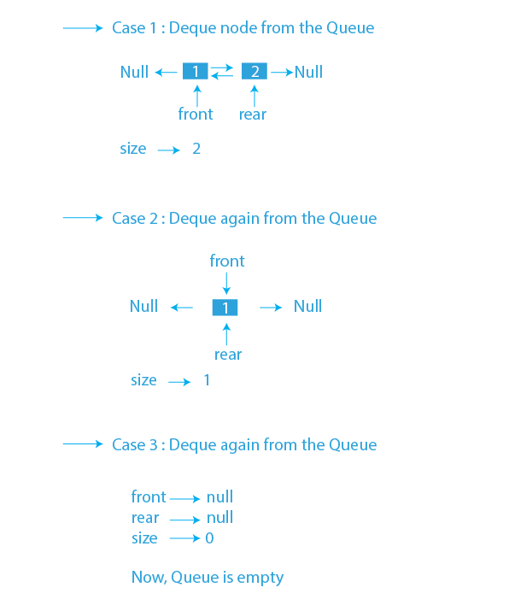
Queue using doubly linked list
Dequeue: This function is used to delete an element from the queue from the front end. From the ref, the front pointer will move to the front->next and will decrease the size pointer by 1. Also, return the data which is stored in the deleted node.
IF front == NULL
print "Underflow"
. ELSE
Initialize temp = front
front = front->next
IF front == NULL
rear = NULL
ELSE
front->prev = NULL
Deallocate space for temp

Slide 30
Queue using doubly linked list
Deletion from front end : .
IF front == NULL
2. print "Underflow"
3. ELSE
4. Initialize temp = front
5. front = front->next
6. IF front == NULL
7. rear = NULL
8. ELSE
9. front->prev = NULL
10 Deallocate space for temp
Deletion from Rear end :
IF front == NULL
2. print "Underflow"
3. ELSE
4. Initialize temp = rear
5. rear = rear->prev
6. IF rear == NULL
7. front = NULL
8. ELSE
9. rear->next = NULL
10 Deallocate space for temp

Slide 31

Polynomial Addition using Linked List
We store each polynomial as a linked list where each node stores exponent and coefficient in the data part and reference to the next node . their sum is then stored in another linked list.

Slide 32
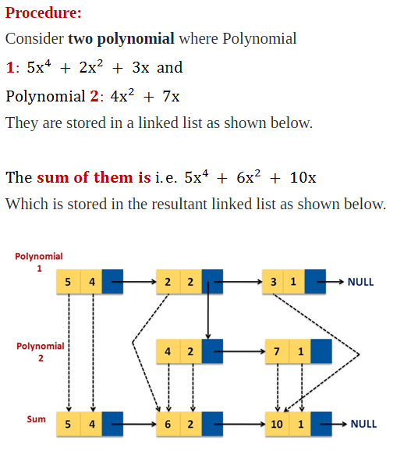
Polynomial Addition using Linked List

Slide 33
Polynomial Addition using Linked List
Create a new linked list, newHead to store the resultant list.
Traverse both lists until one of them is null.
If any list is null insert the remaining node of another list in the resultant list.
Otherwise compare the degree of both nodes, a (first list as node) and b (second list as node). Here three cases are possible:
If the degree of a and b is equal, we insert a new node in the resultant list with the coefficient equal to the sum of coefficients of a and b and the same degree.
If the degree of a is greater than b, we insert a new node in the resultant list with the coefficient and degree equal to that of a.
If the degree of b is greater than a, we insert a new node in the resultant list with the coefficient and degree equal to that of b.

